Slide 1
Memory Organization
LEC :7

Slide 2
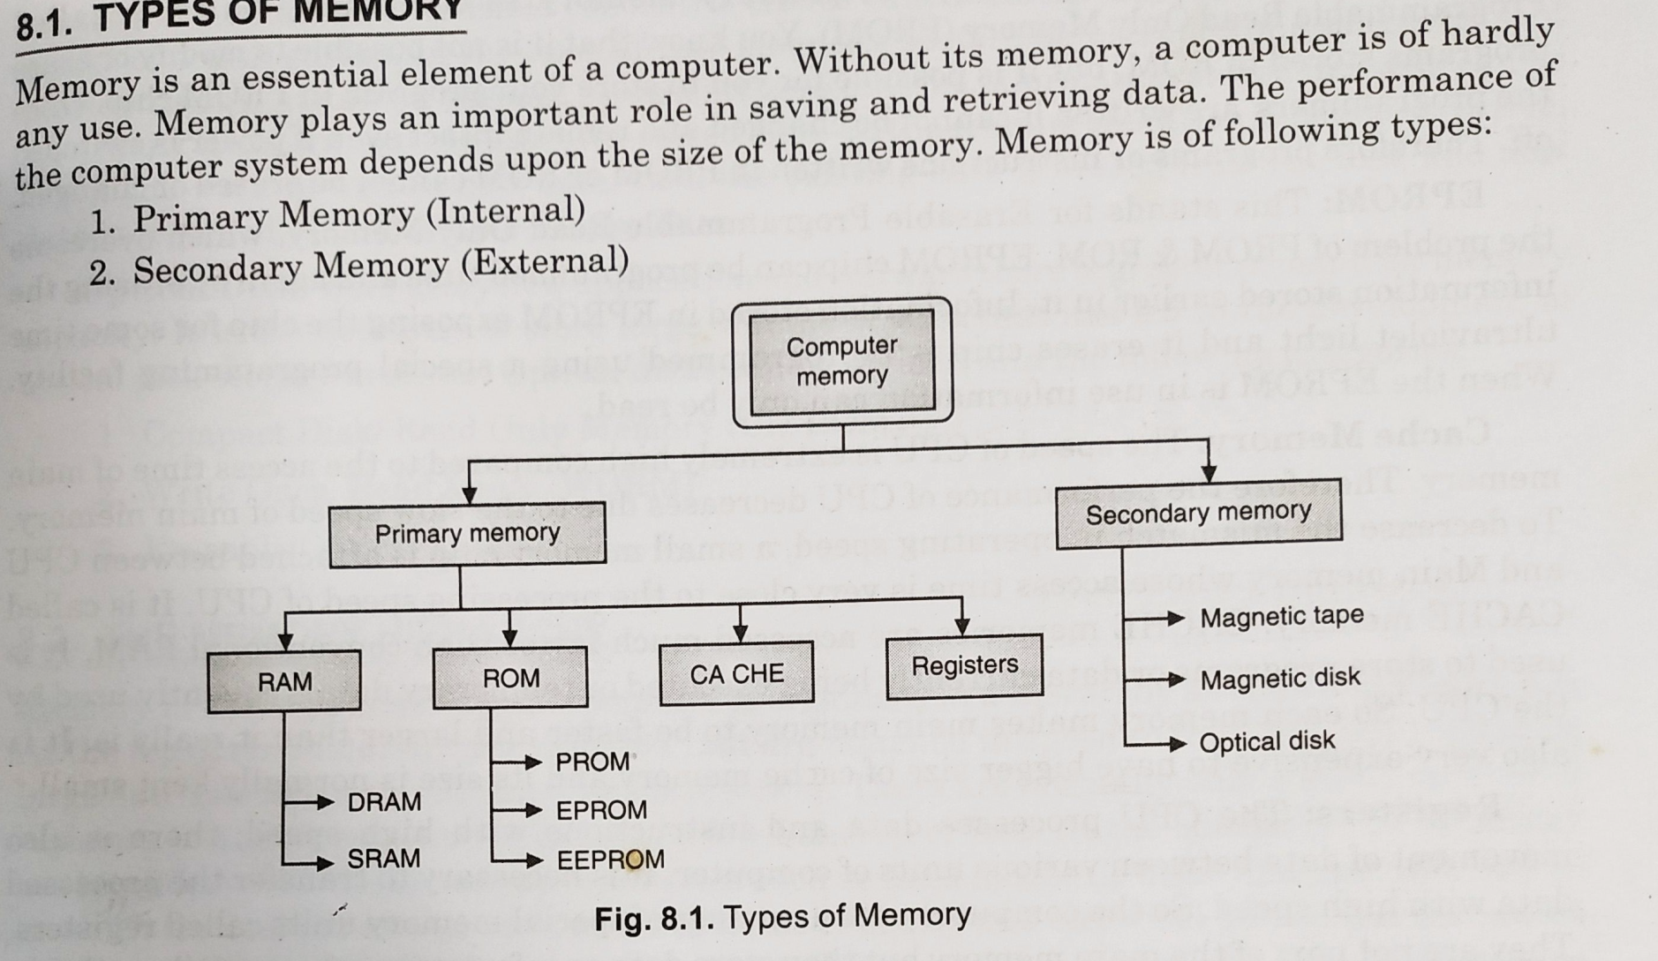
TYPES OF MEMORY

Slide 3
MEMORY HIERARCHY
Memory Hierarchy is to obtain the highest possible
access speed while minimizing the total cost of the memory system
Auxiliary memory
Magnetic
tapes
I/O
Main
processor
memory
Magnetic
disks
CPU
Cache
memory
Register
Cache
Main Memory
Magnetic Disk
Magnetic Tape

Slide 4
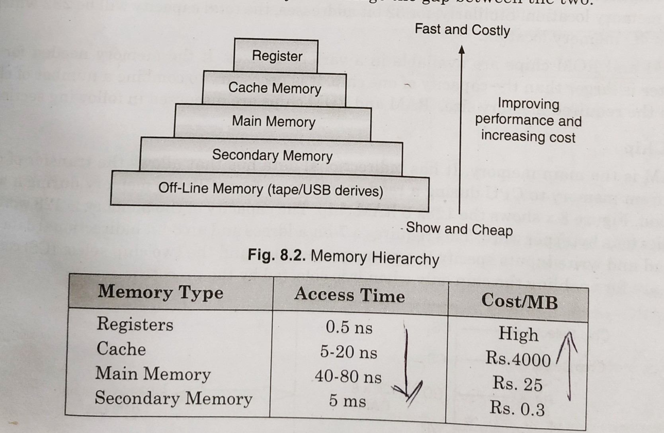
THE MEMORY HIERARCHY

Slide 5
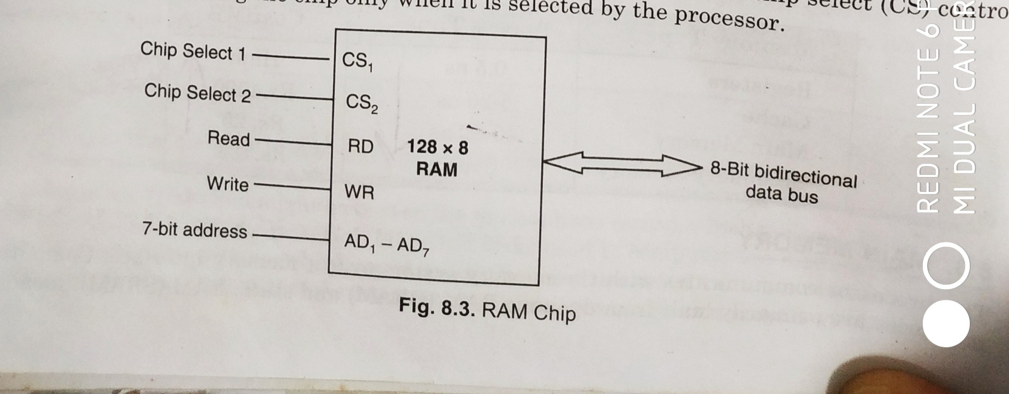
RAM CHIPS

Slide 6
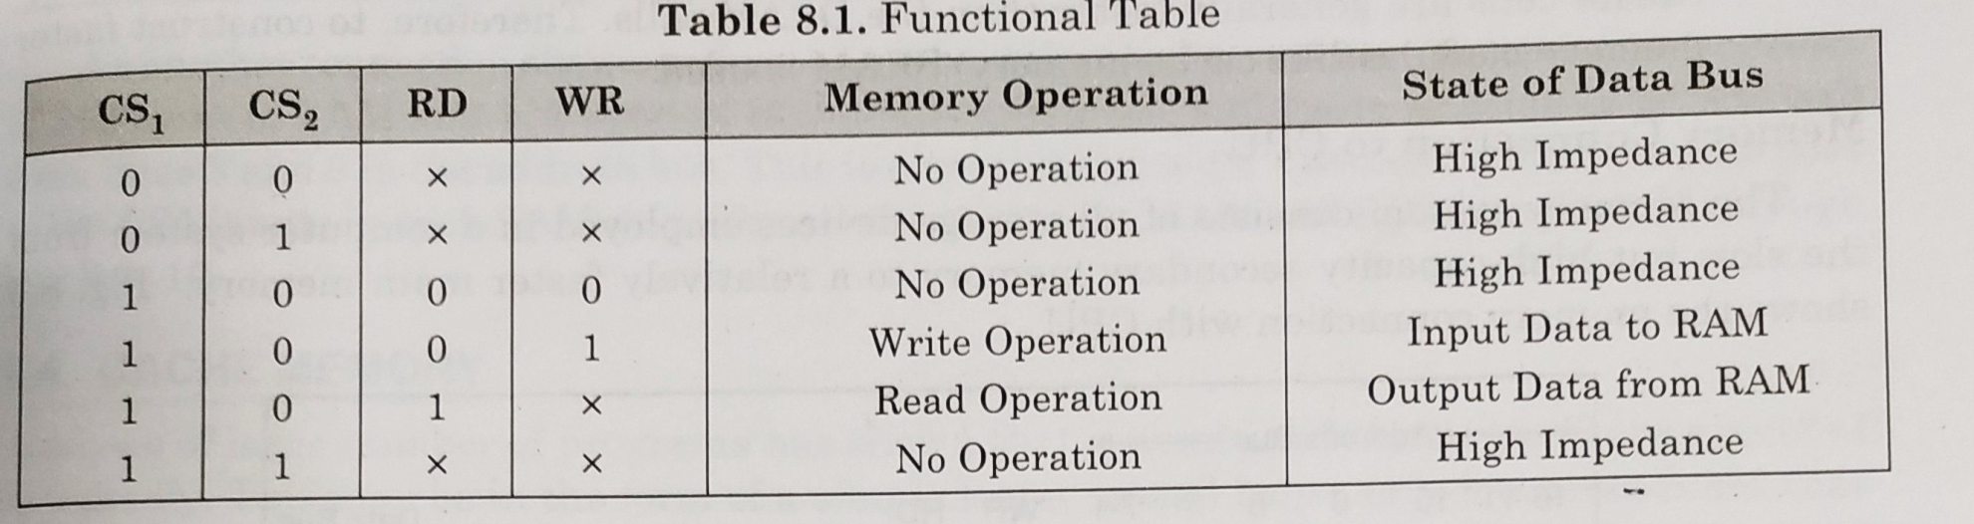
FUNCTIONAL TABLE OF RAM

Slide 7
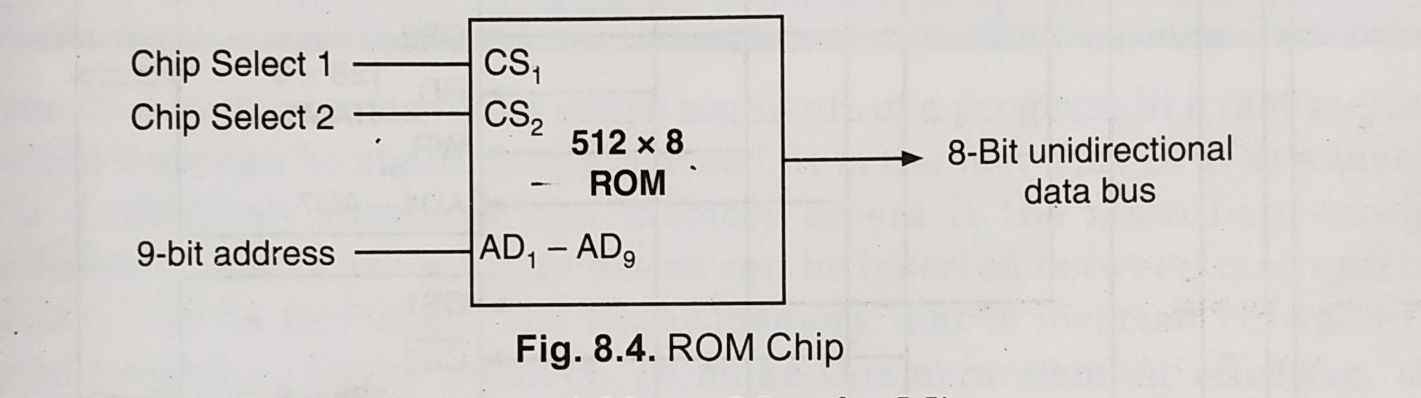
ROM CHIPS

Slide 8
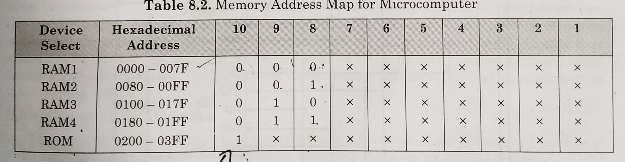
Memory address map of RAM

Slide 9
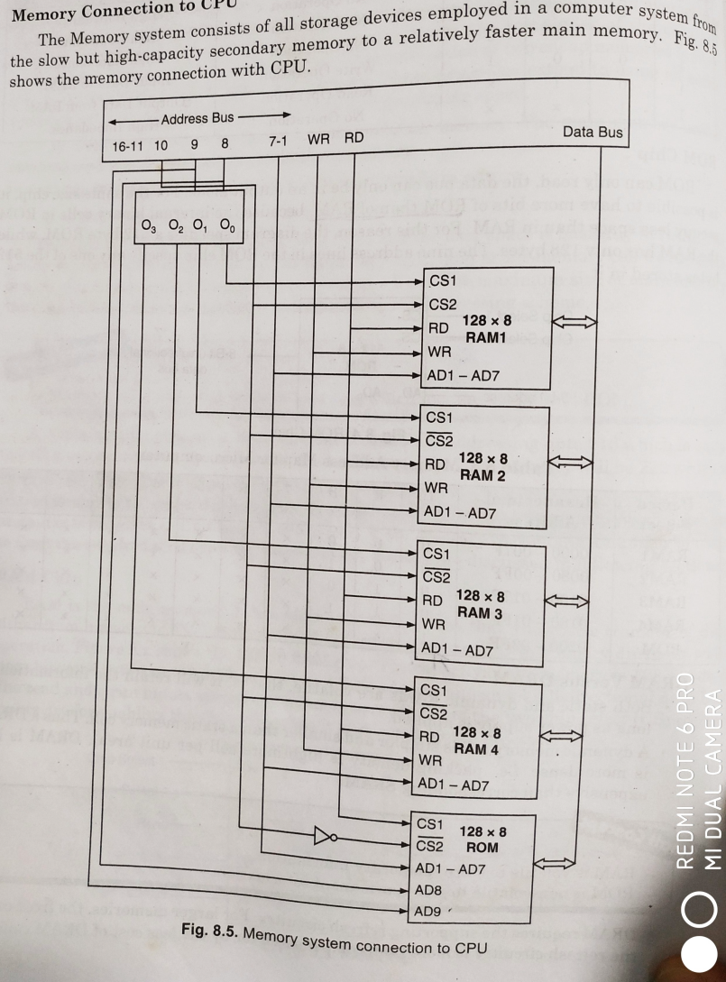
Memory connection to CPU

Slide 10
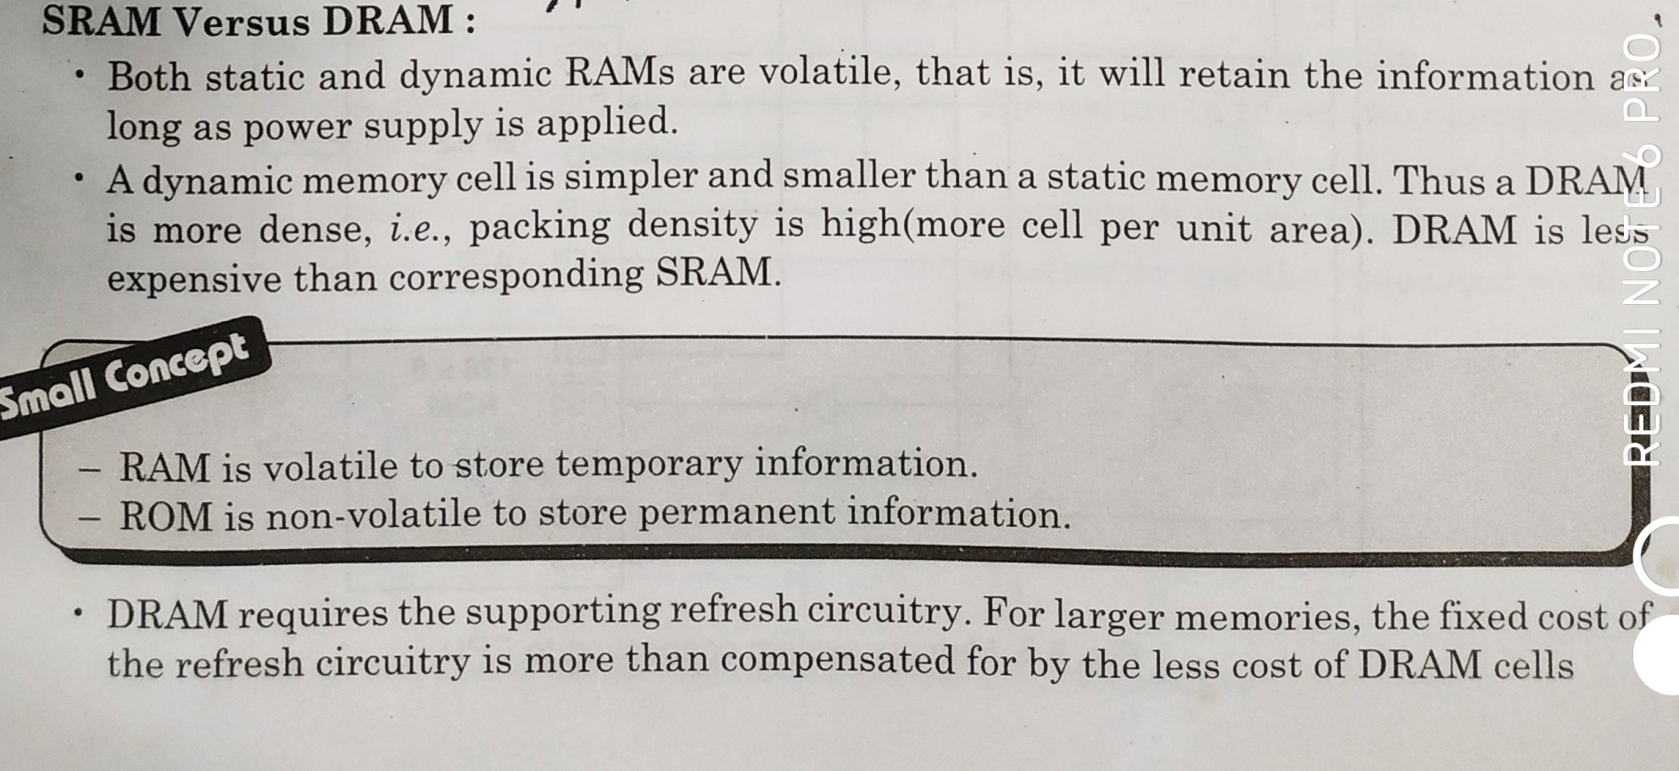
SRAM VS DRAM

Slide 11
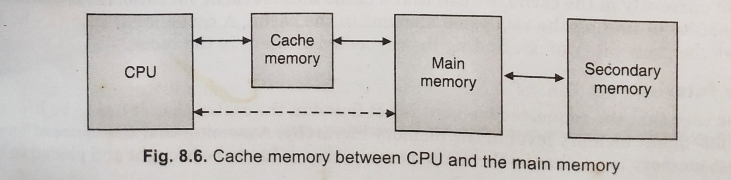
CACHE MEMORY

Slide 12
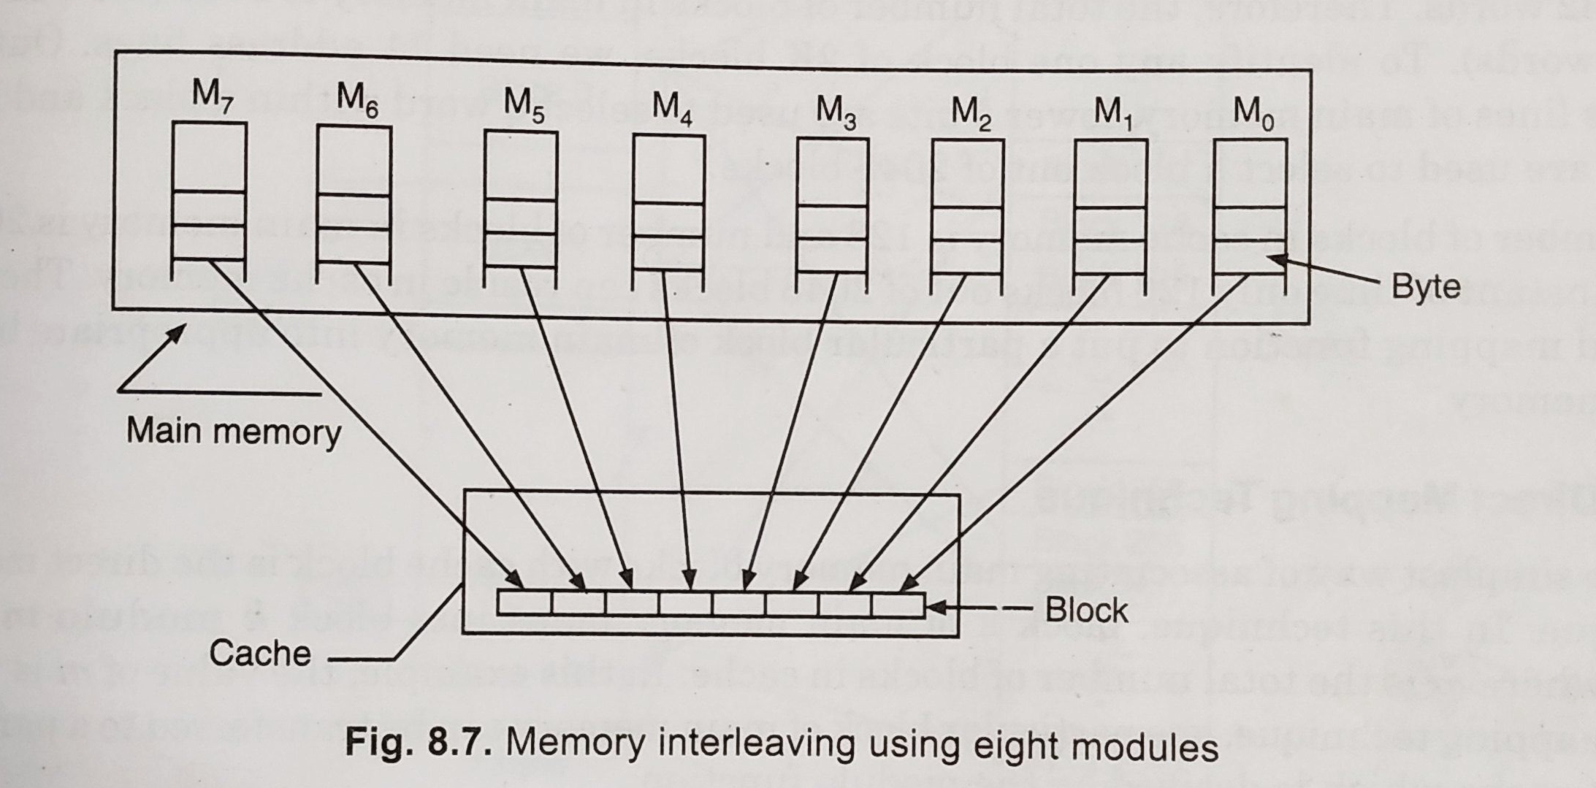
MEMORY INTERLEAVING

Slide 13
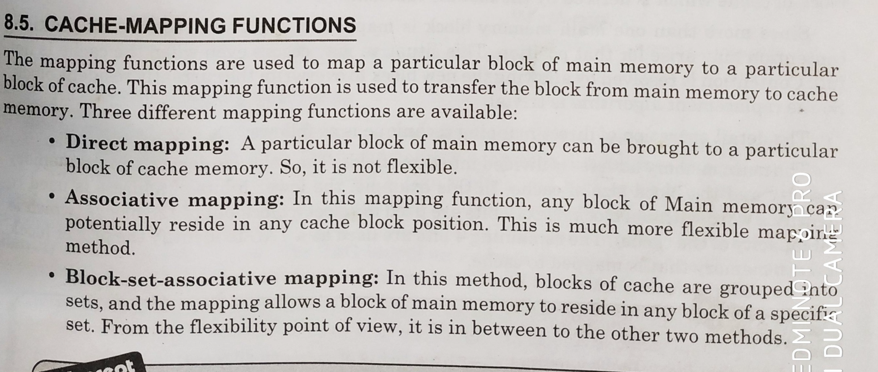
CACHE MAPPING FUNCTION

Slide 14
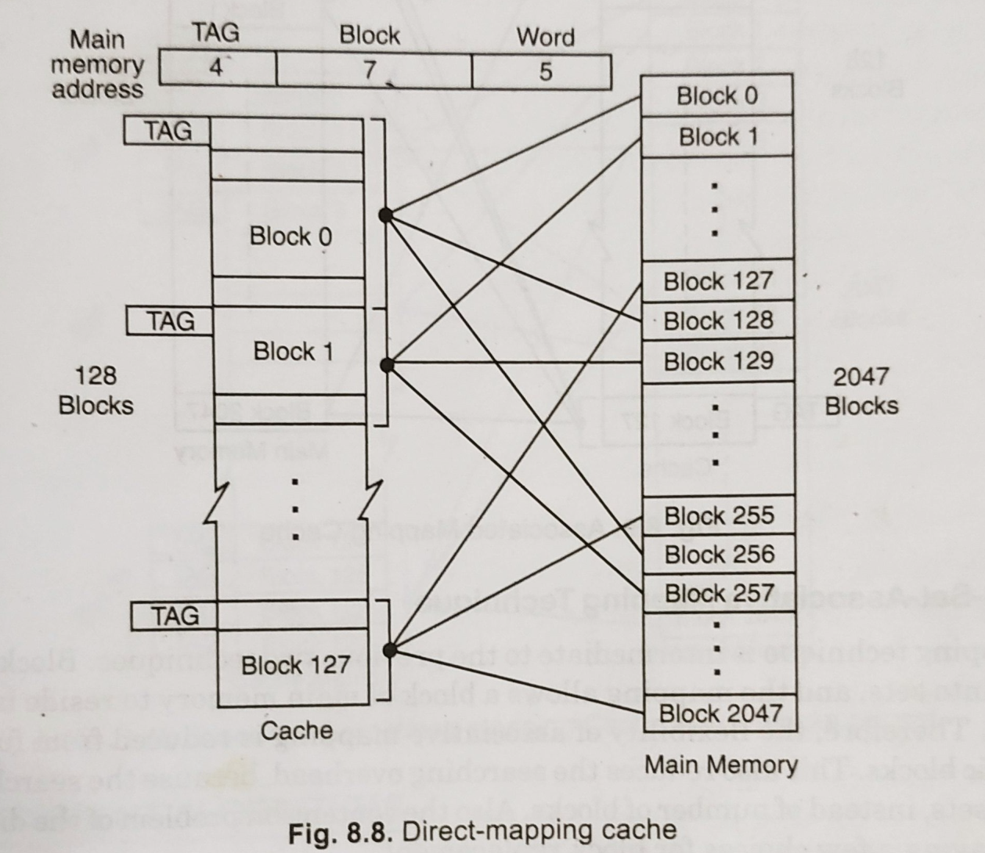
DIRECT MAPPING

Slide 15
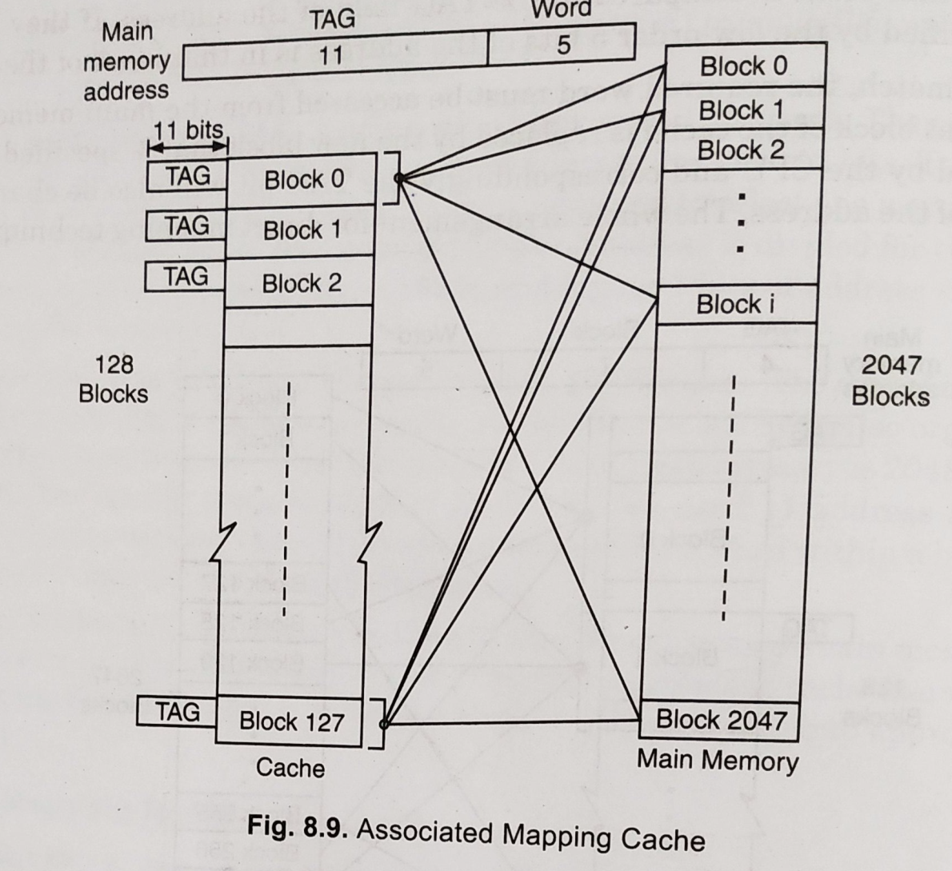
ASSOSIATIVE MAPPING

Slide 16
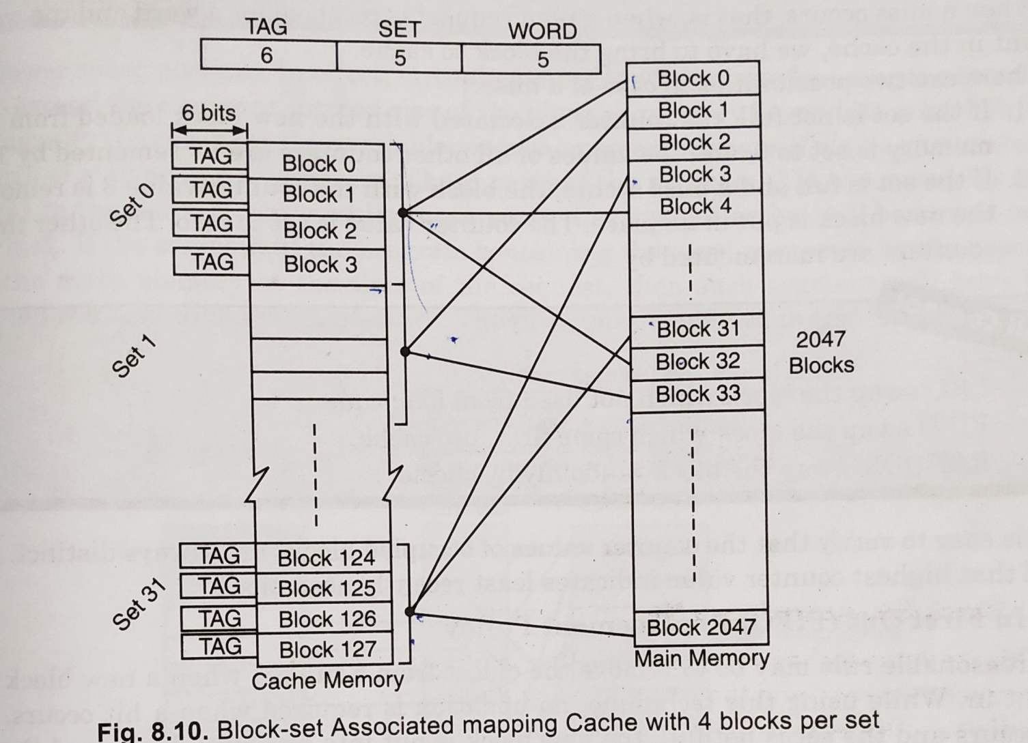
BLOCK SET ASSOCIATIVE MAPPING

Slide 17
REPLACEMENT ALGORITHAM
LRU replacement policy
FIFO replacement policy
Random replacement policy

Slide 18
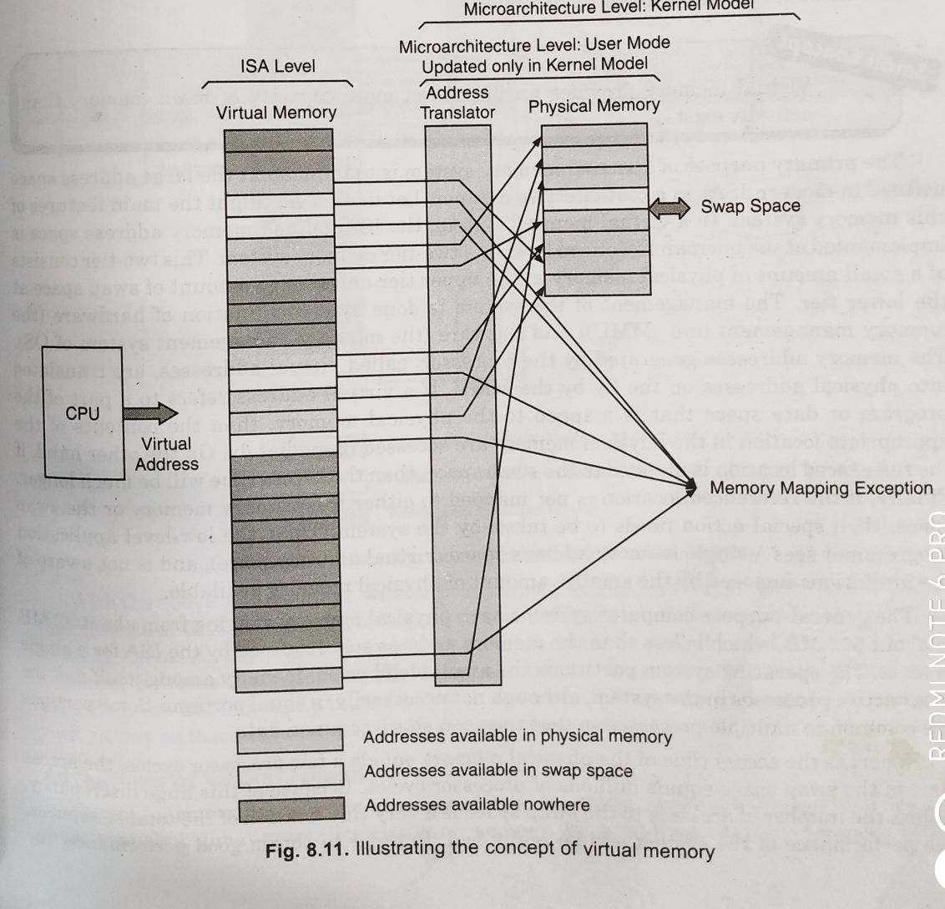
VIRTUAL MEMORY

Slide 19
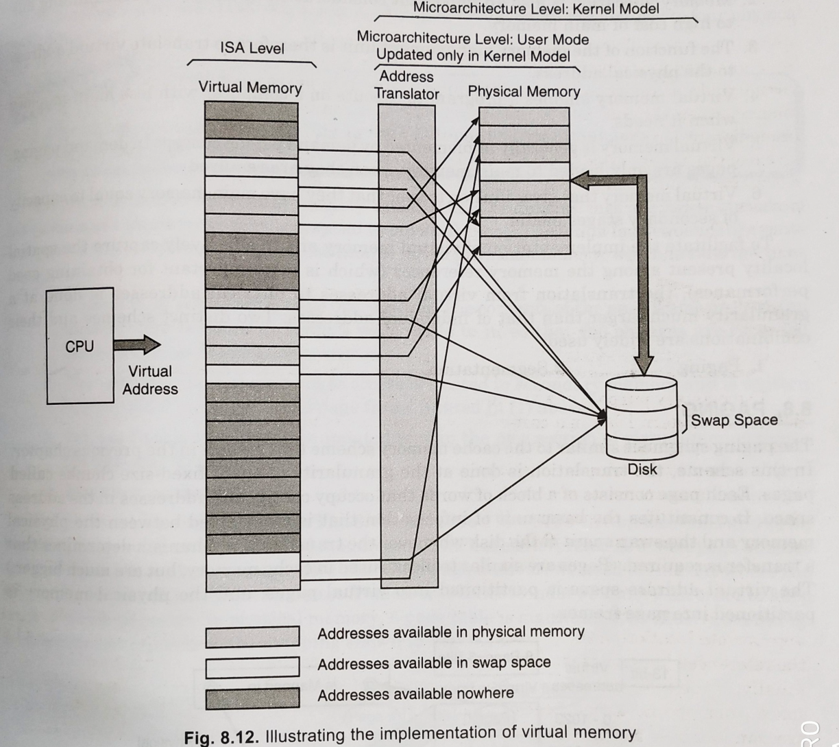
VIRTUAL MEMORY

Slide 20
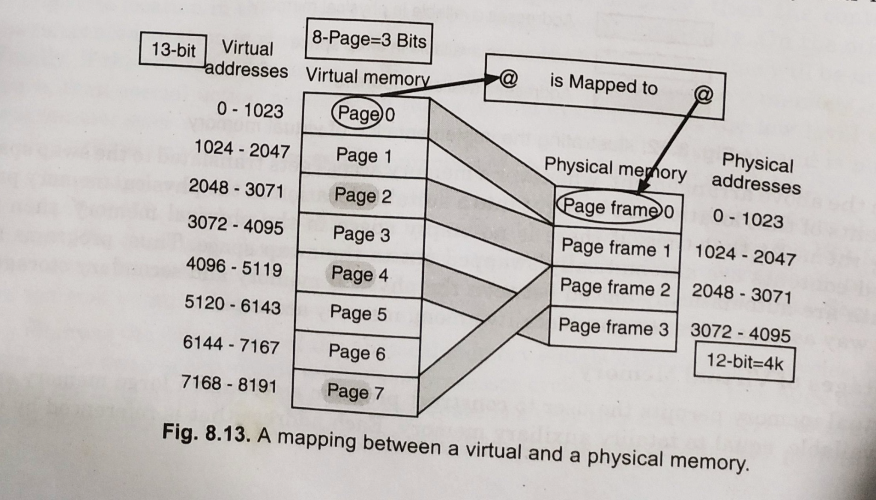
PAGEING

Slide 21
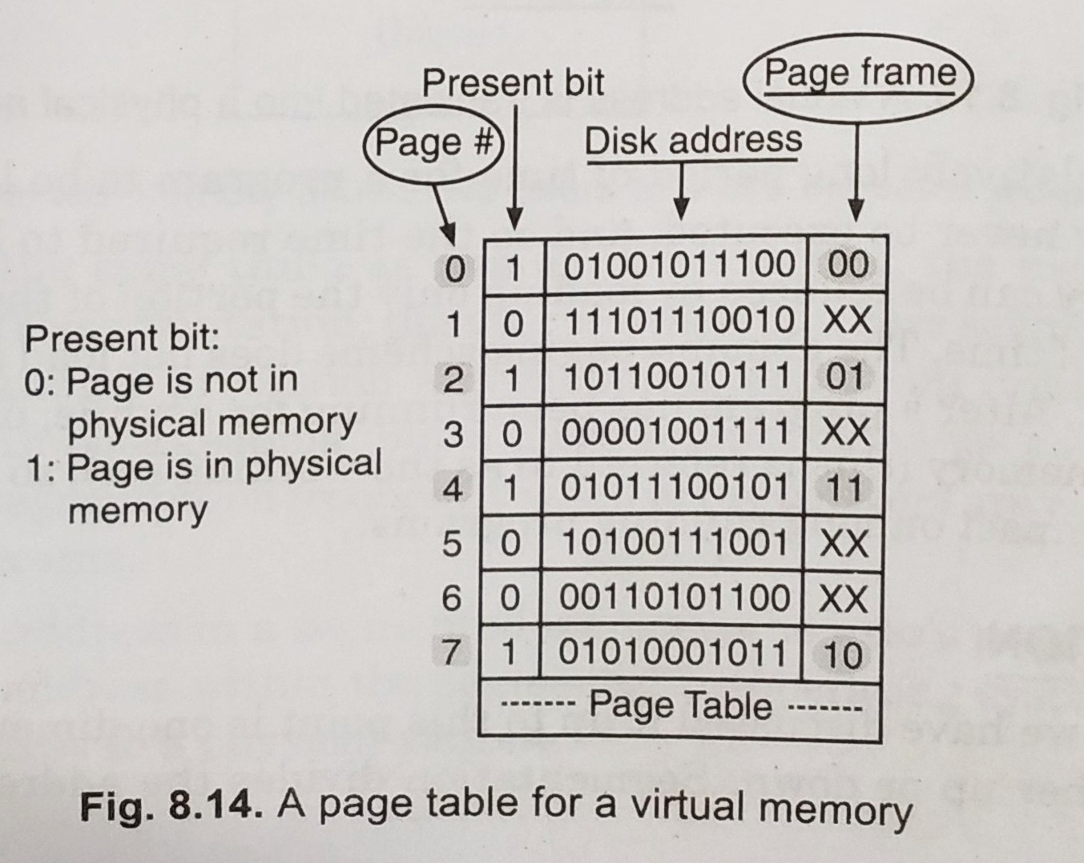
PAGEING

Slide 22
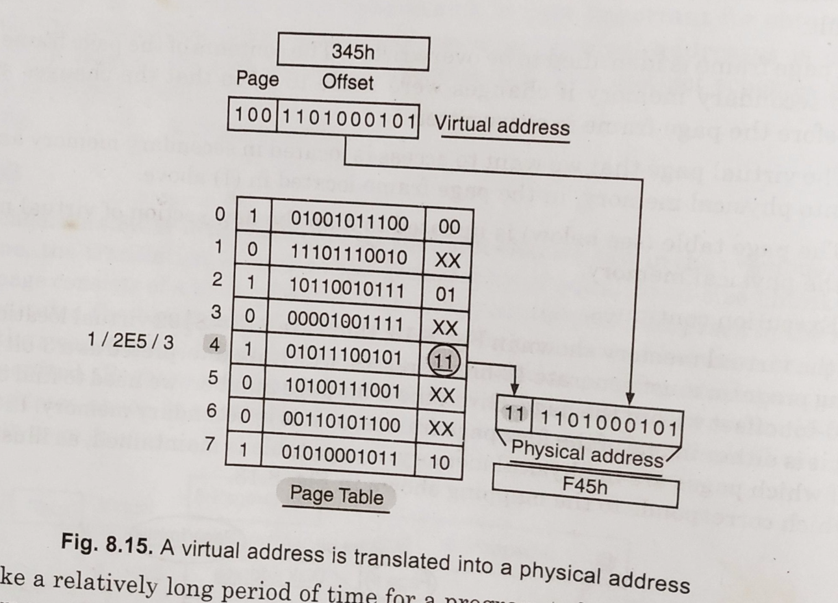
PAGEING

Slide 23
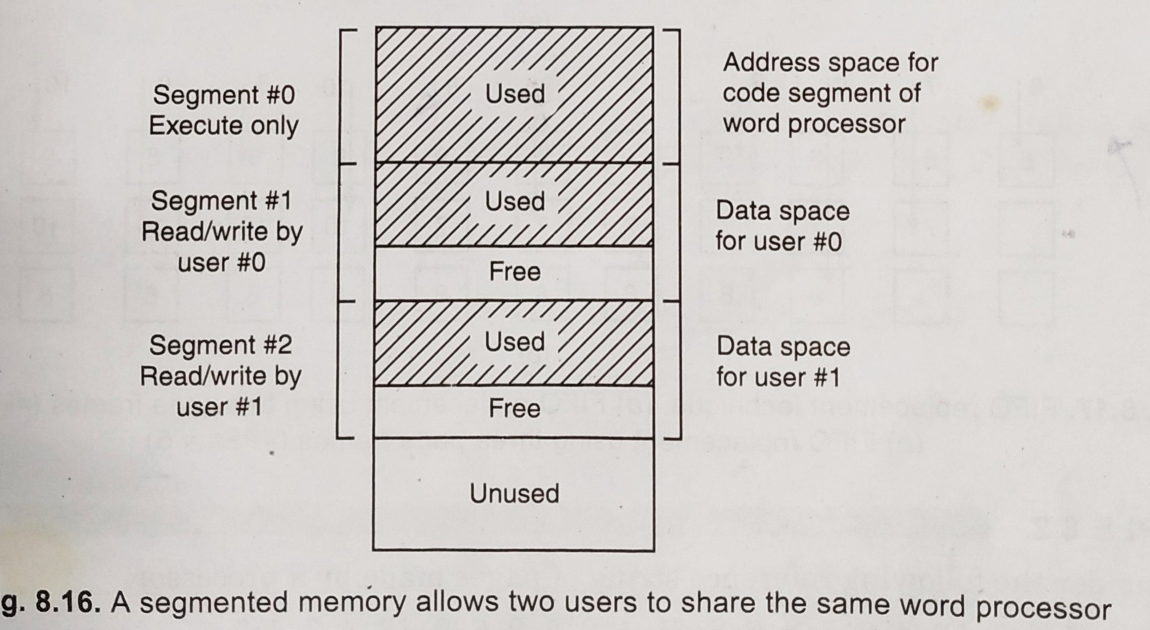
SEGMENTATION

Slide 24
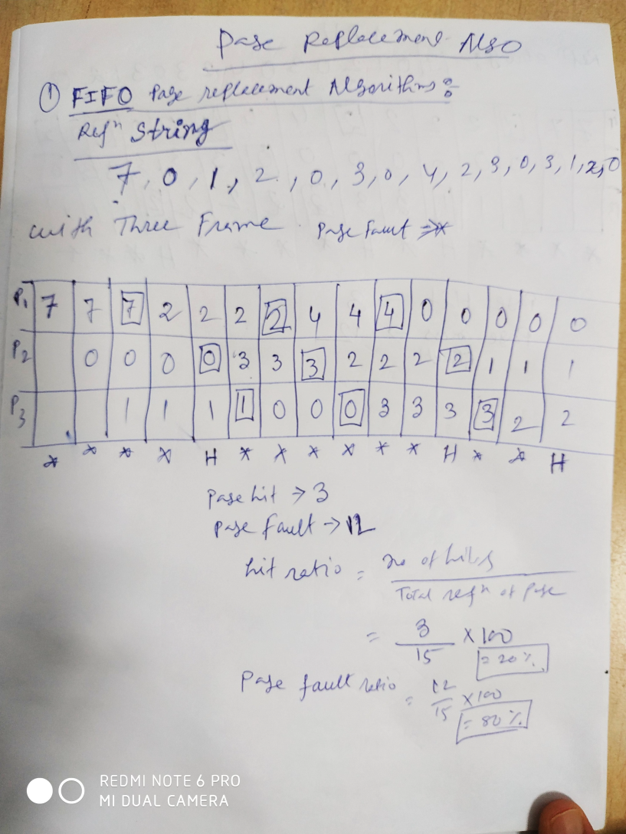
PAGE REPLACEMENT ALGORITHMS FIFO

Slide 25
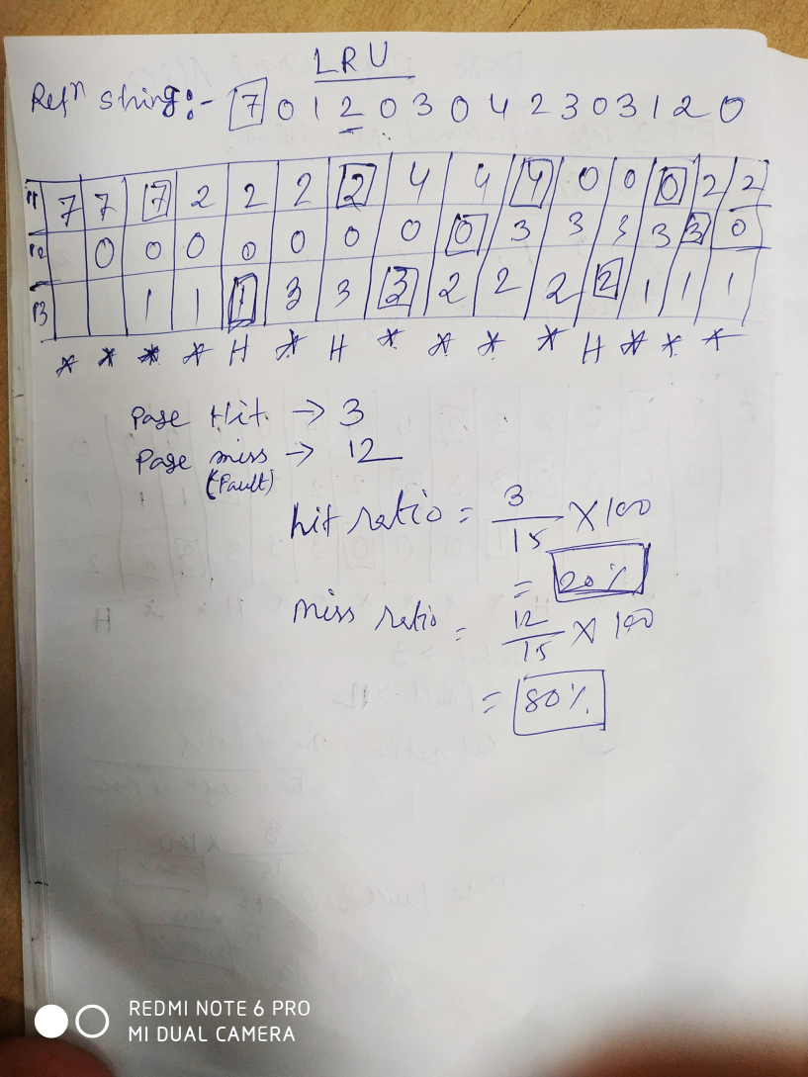
LEAST RECENT USED ALGORITHMS

Slide 26
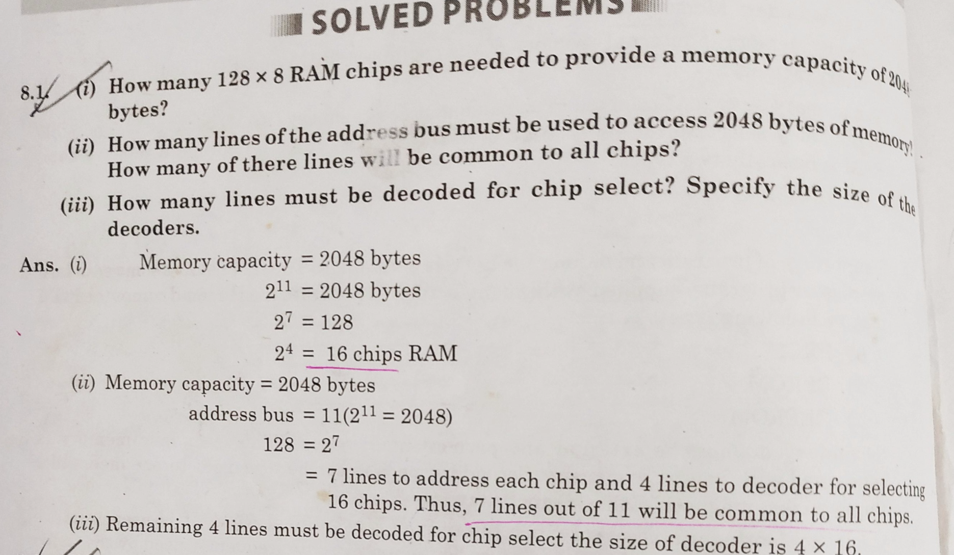
PROBLEMS

Slide 27
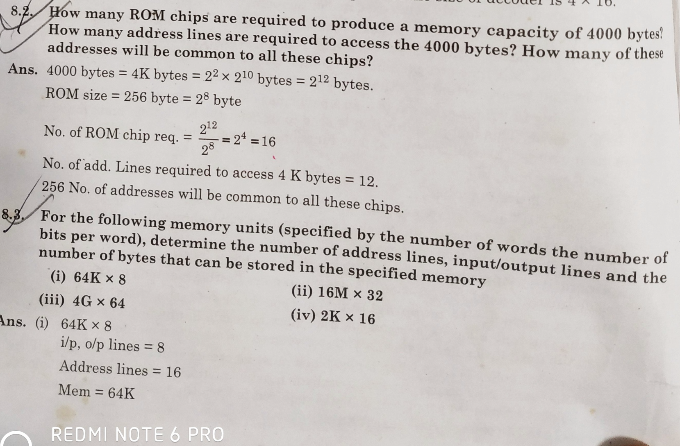
PROBLEMS

Slide 28
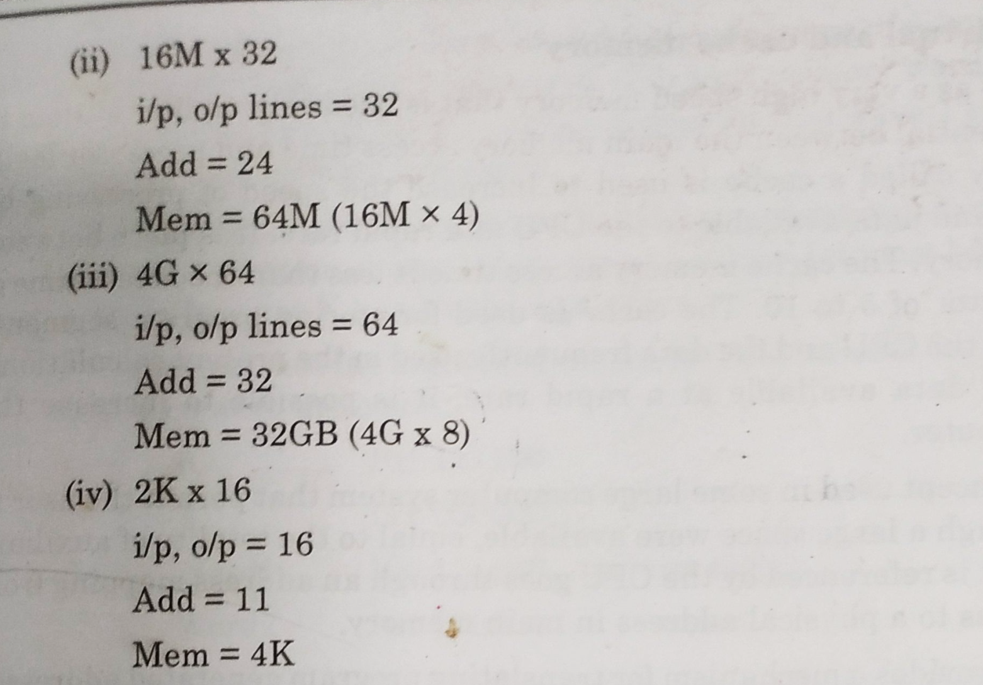
PROBLEMS

